Slide 1

Honda EV Conversion Kit Capstone Initial Testing Results
Paul Howell, Wyatt Watson, Josh Hattaway, David Brooks, and Bryce Greenberg

Slide 2
Design Requirements
Table 1: CR's and ER's
Customer Requirement | Developed Engineering Requirement
CR1 - Battery life sufficient for average commuter | ER1 - Range greater than 100 miles
CR2 - Six or more batteries in vehicle | ER2 - Increase battery capacity greater than 40 kWh
CR3 - Consumer sellable (safe and durable) product | ER3 - Reduce cost of production ($)
CR3 - Consumer sellable (safe and durable) product | ER4 - Maximize power output 300 hp
CR3 - Consumer sellable (safe and durable) product | ER5 - Maximize torque output 250 ft-lb
CR4 - Lightweight | ER6 - Decrease weight less than 3000 lbs.
CR5 - Cooling system for electric motor | ER7 - Cool components to less than 200°F
CR6 - Compatibility with similar vehicle models | ER8 - Reduce number of mounts, 5 or less
Joshua Hattaway

Slide 3
Top Level Testing Summary
Ten tests planned
  8 for verifying Design Requirements
  2 for guaranteeing safety of drivers
Table 2: Testing overview
Experiment/Test | Relevant DRs
EX1 – Weight Test | CR4, ER6
EX2 – Battery Voltage Test | CR1, CR2, ER1, ER2
EX3 – Pre-Drive Electrical Test | CR3
EX4 – Pre-Drive Rigidity Test | CR3
EX5 – Range Test | CR1, CR2, ER1, ER2
EX6 – Production Process Test | CR3, ER3
EX7 – Compatibility Test | CR6, ER8
EX8 – Cooling Test | CR5, ER7
EX9 – Power Output Test | CR3, ER4
EX10 – Torque Output Test | CR3, ER5
Joshua Hattaway

Slide 4
Detailed Testing Plans
In-depth description of tests
> 25% complete
Majority of tests will be completed after final wiring
Completed tests:
  Weight
  Pre-drive electrical test (half completed)
  Production Process
  Fitment
  Battery Voltage
Paul Howell

Slide 5
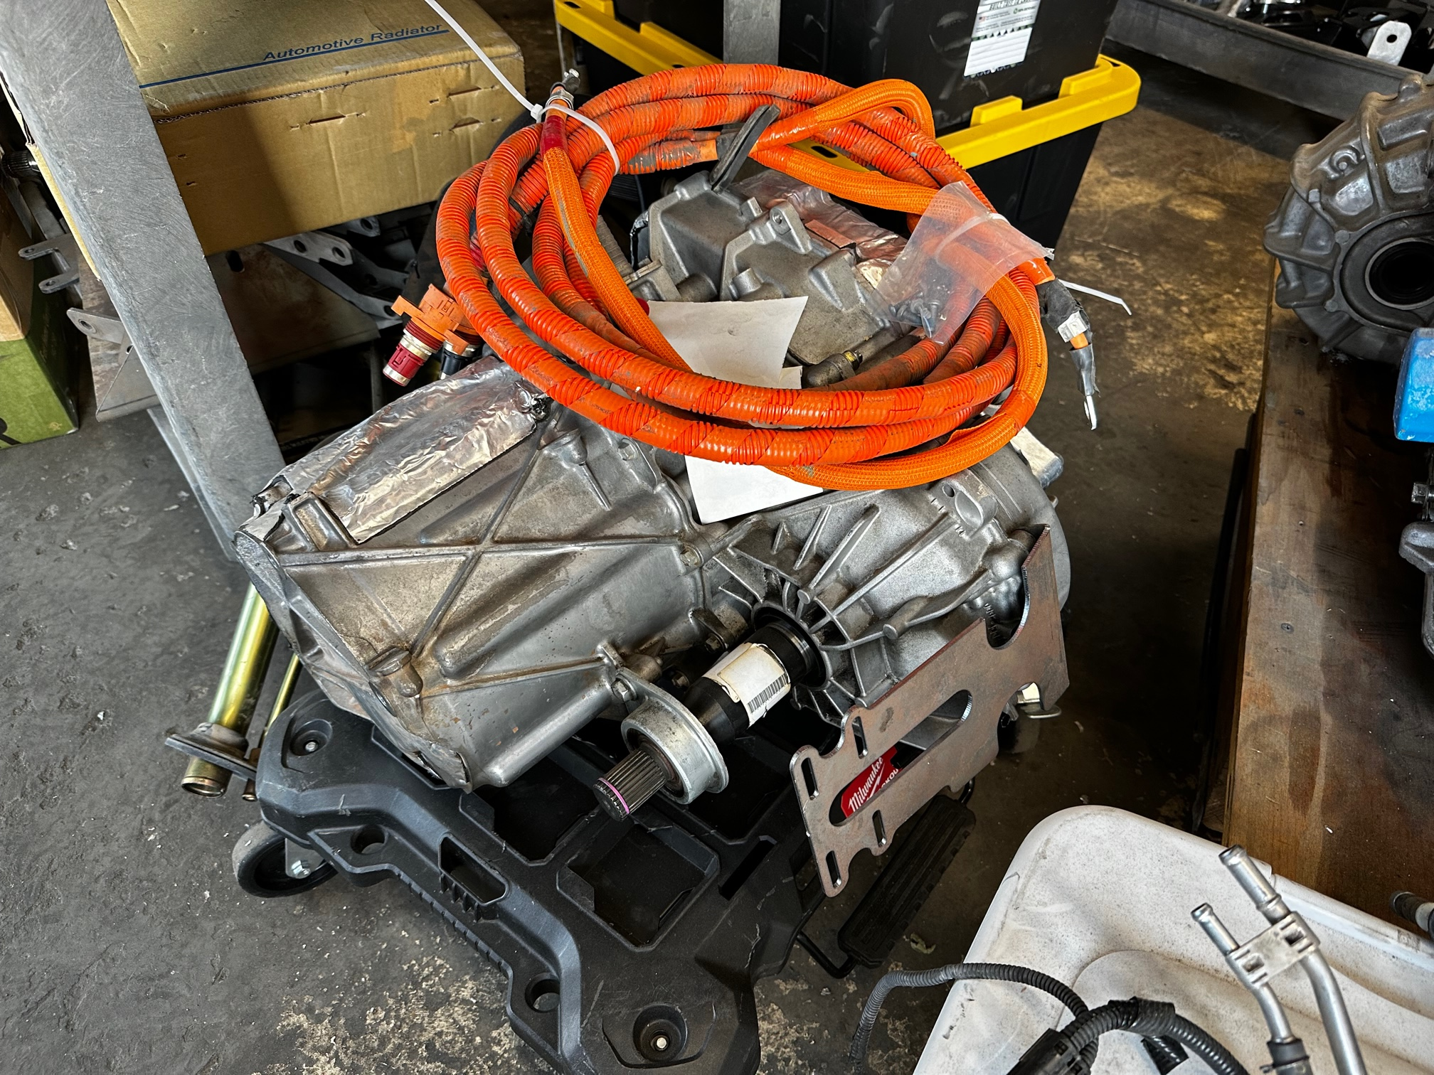
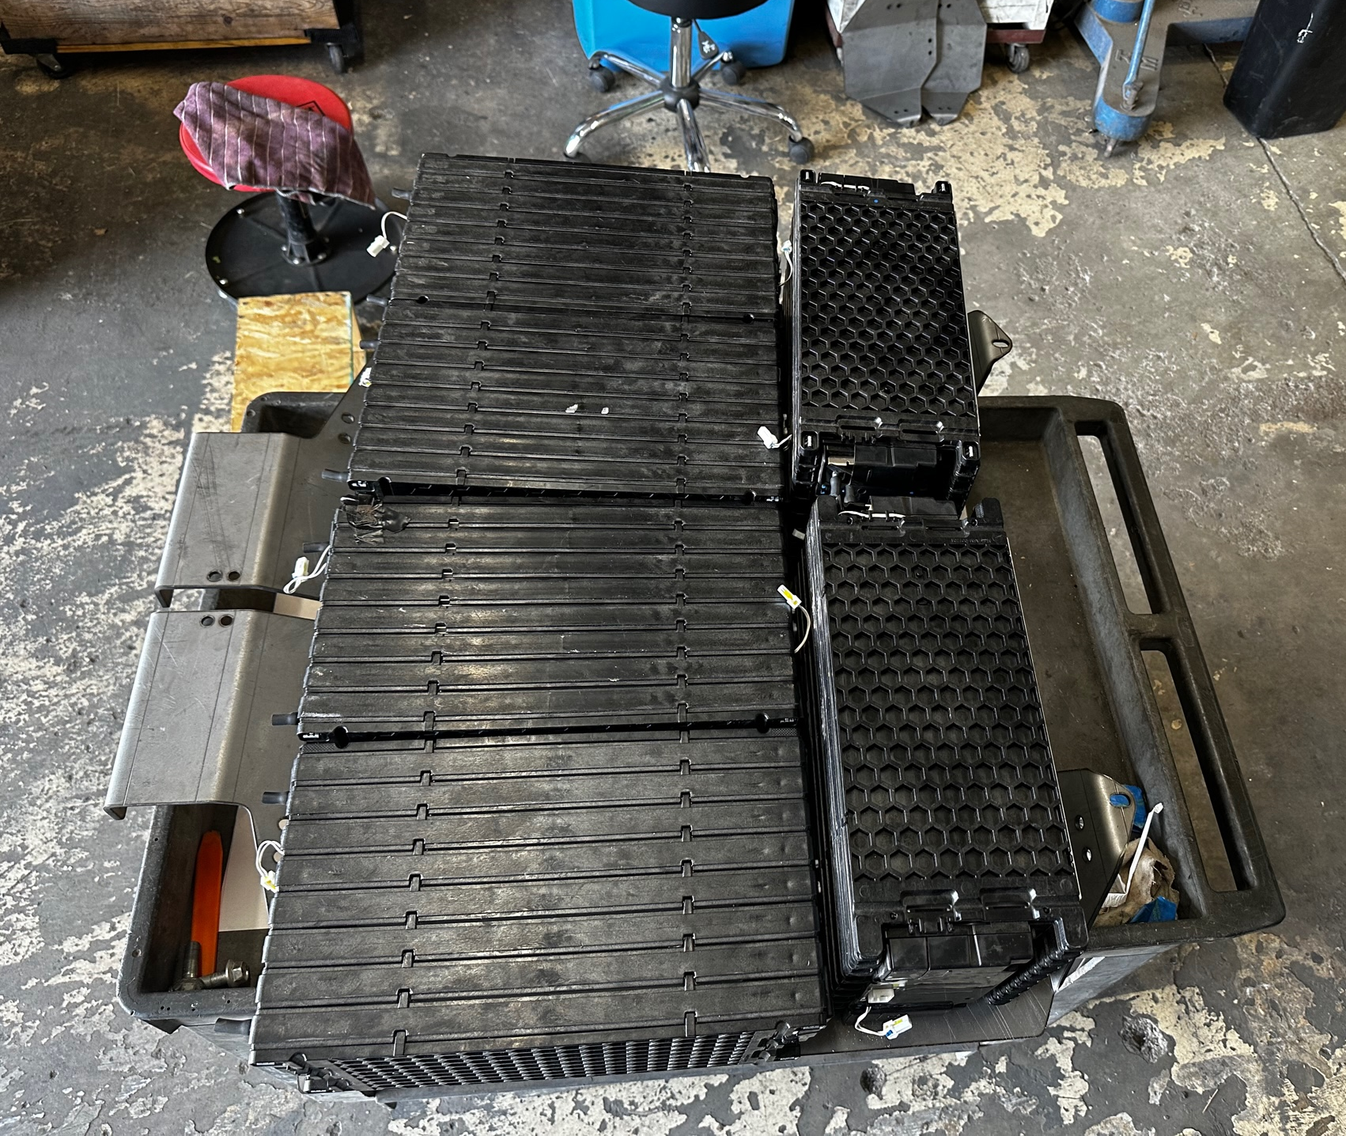
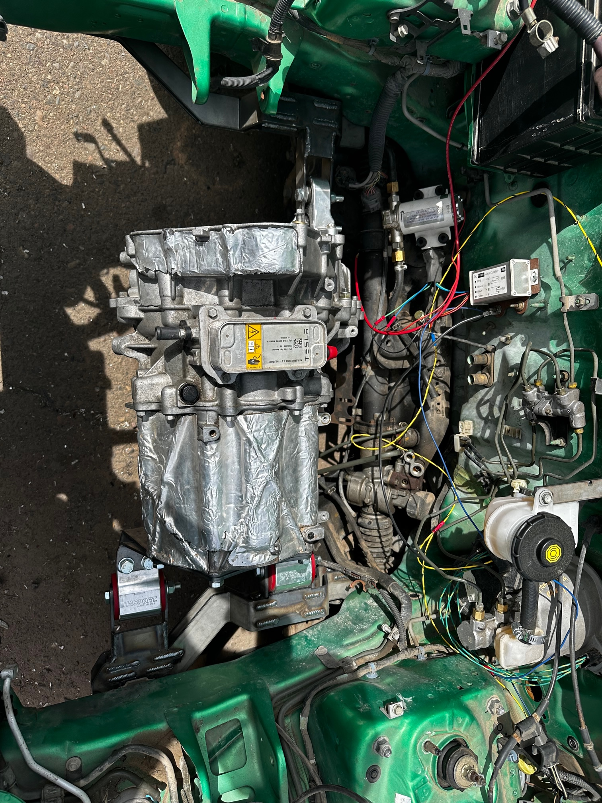
Weight Test
Research
Research and determine weight of vehicle, original engine, and Tesla small drive unit.
Calculate
Calculate gross weight of assembled vehicle by adding together individual component weights.
Weigh
Weigh vehicle and compare to previously calculated. (Vehicle gained approximately 300 pounds, but more than doubled power)
Figure 1: Tesla motor
Figure 2: Batteries and mounts
Figure 3: Motor mounts
Paul Howell

Slide 6
Pre-Drive Electrical Test
Power on and check critical safety and operational components
  12 Volt System (Lights, Horn, etc) has been fully validated
  400 Volt System in progress
    External charger validated
    Battery connections validated
    Motor connections validated
    Main contactor validated
    On board charger in progress
Paul Howell

Slide 7
Production Process Test
BOM
Determine final Bill of Materials
Hardware Prices
Determine cost of hardware
Laser Cutting
Get sheet metal pieces laser cut.
Assembly Time
Time the process to fully assembly mounts.
Total Cost
Sum together all aspects of production.
David Brooks

Slide 8
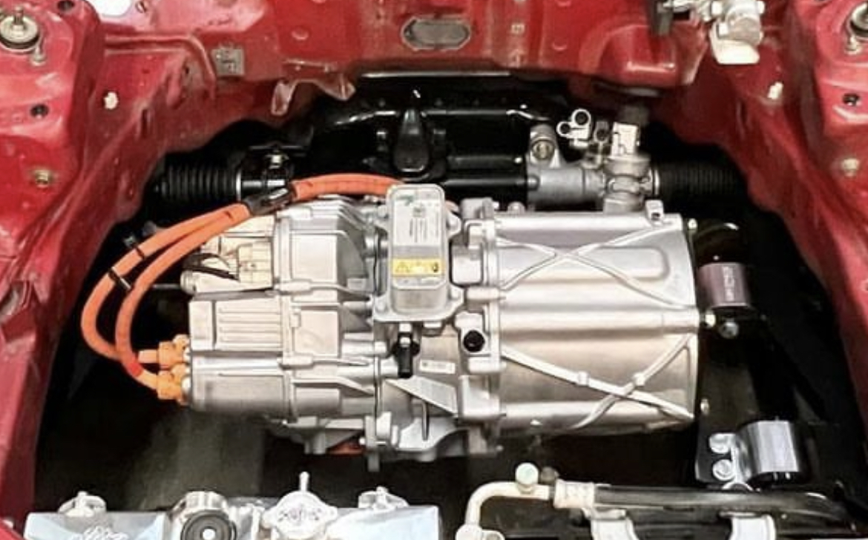
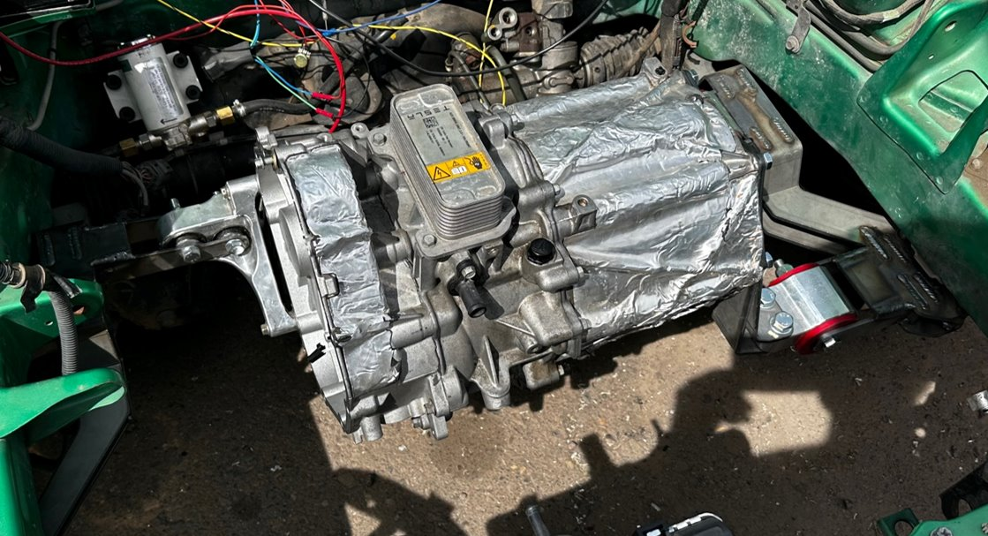
Fitment Test
Final test fit
Test final design into teams Honda Del Sol.
Second vehicle fitment
Confirm fitment in EG Civic
Third vehicle fitment
Confirm fitment in Acura Integra
David Brooks

Slide 9
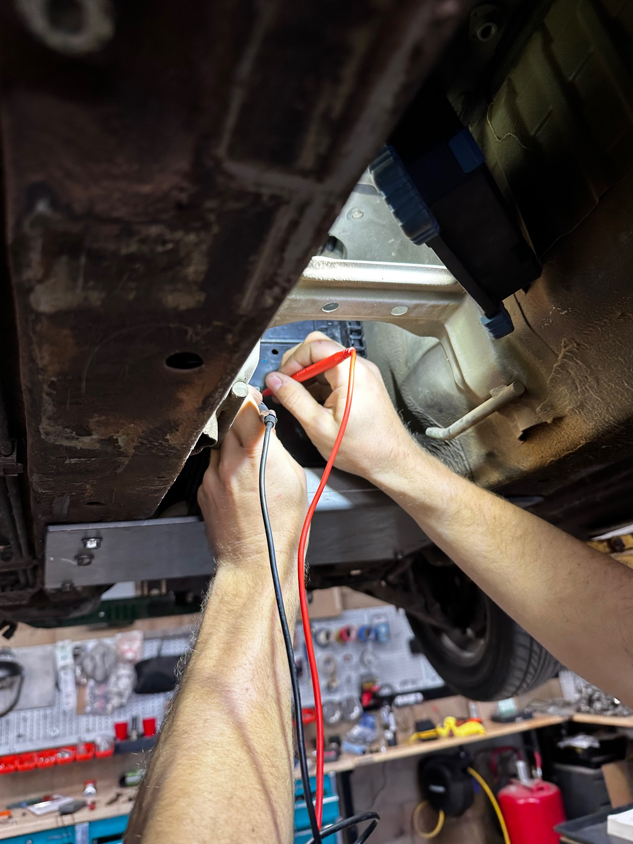
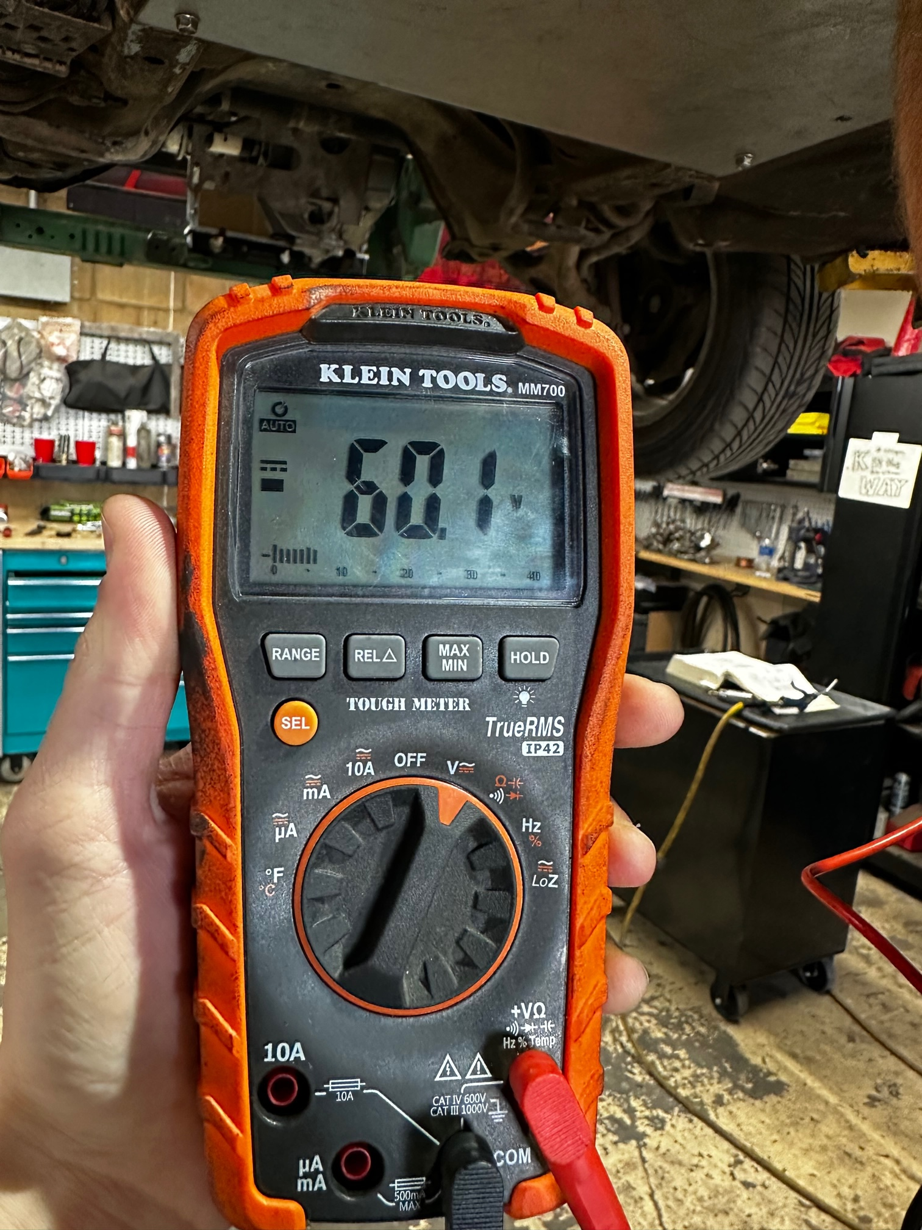
Battery Voltage Test
Test voltage of each of the 6 LG Chem batteries with multimeter
  Ensure voltage levels meet manufacturer nominal motor requirements (275-420V, target of 400)
  Fully charged batteries: 6 x 60.1 V = 360.6V
Calculate capacity per pack
  45Ah (per cell) x 360.6 V = 16 kWh
Figure 4: Testing voltage of battery module
Figure 5: Battery voltage reading
Wyatt Watson

Slide 10
Specification Sheet
Table 3: Spec sheet CR's
Customer Requirement | CR met? (✓or X) | Client Acceptable (✓or X)
CR1 - Battery life sufficient for average commuter
CR2 - Six or more batteries in vehicle | ✓ | ✓
CR3 - Consumer sellable (safe and durable) product | ✓ | ✓
CR4 - Lightweight | ✓ | ✓
CR5 - Cooling system for electric motor
CR6 - Compatibility with similar vehicle models | ✓ | ✓
Table 4: Spec sheet ER's
Engineering requirement | Target | Tolerance | Measured/ Calculated Value | ER met? (✓or X) | Client Acceptable? (✓or X)
ER1 – Vehicle Range | 100 Miles | >100
ER2 – Battery Capacity | 10 kWh | >10 | 16 kWh | ✓ | ✓
ER3 – Production Cost | $1,000 | <1,000 | $300 | ✓ | ✓
ER4 – Power Output | 300 hp | +/- 20 hp
ER5 – Torque Output | 250 ft-lbs | +/- 20 ft-lbs
ER6 – Vehicle Weight | 3,000 lbs | + 50 lbs | 2355 lbs | ✓ | ✓
ER7 – Component Cooling | 200 °F | Less Then 200 °F
ER8 – Quantity of Mounts | 5 | Less Then 5 | 4 | ✓ | ✓
Wyatt Watson

Slide 11
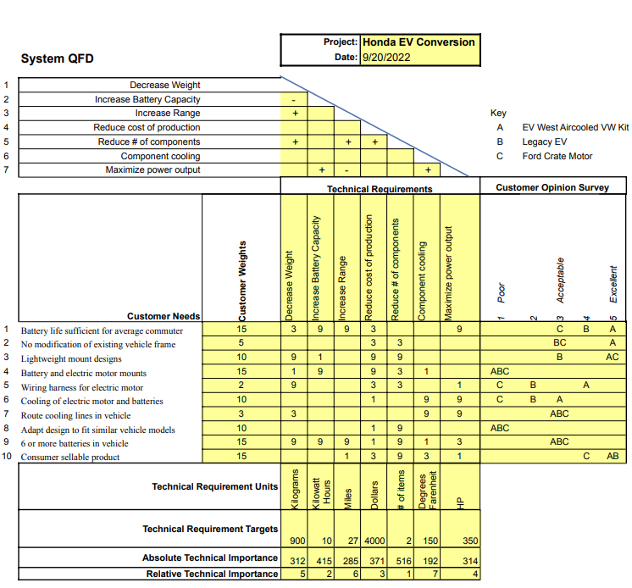
QFD
Figure 6: Quality functional development
Bryce Greenberg

Slide 12
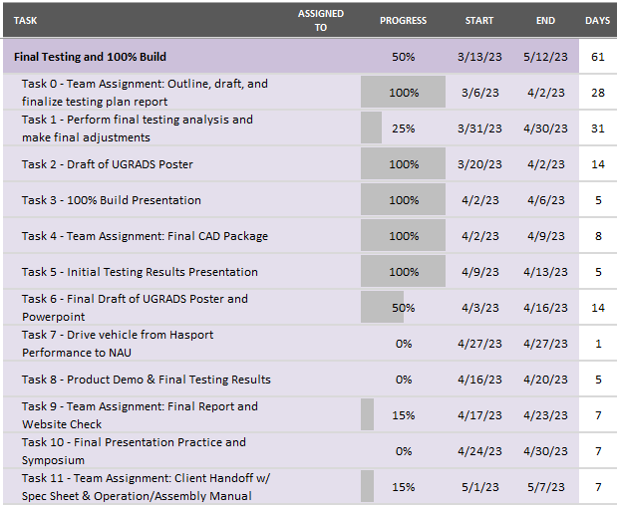
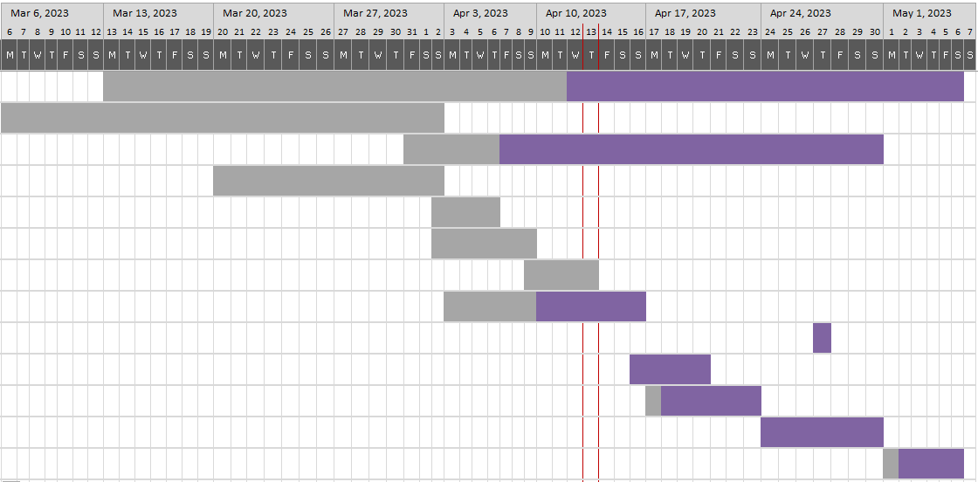
Gantt Chart – Updated for testing results
Figure 7 and 8: Gantt chart and current testing progress
Bryce Greenberg

